Slide 1
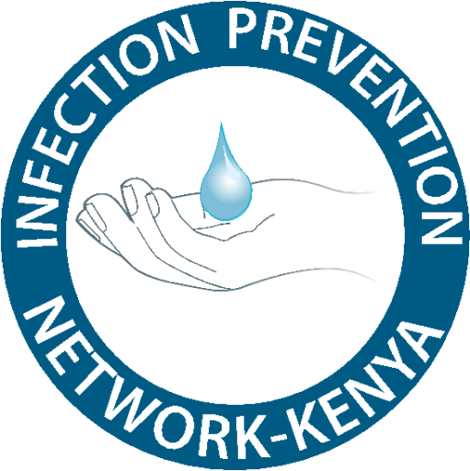


Sustainable IPC Approaches for Health System Strengthening
LUCY WALEGWA
NEPHROLOGY AND TRANSPLANT NURSE
KENYATTA UNIVERSITY TEACHING RESEARCH AND REFFERAL HOSPITA
Name, credentials
Institution affiliation
Head Shot

Slide 2
Overview
This is a literature review study done in Kisumu, Turkana, Makueni, Nairobi and Kilifi county.
Mixed methods: facility audits, mobile surveillance data, interviews
Innovations evaluated:
• Mobile AMR surveillance (AfyaTrack)
• Solar-powered hand hygiene stations
• Community-fabricated PPE
• Onsite water purification systems

Slide 3
Data Reported on Mobile AMR surveillance (AfyaTrack)
Confirmed infection cases by type (e.g., respiratory, urinary, bloodstream)
Patient demographics (age, sex, location)
Identification of antimicrobial-resistant strains
Resistance patterns to specific antibiotics
Trends in resistance over time

Slide 4
Data Reported on Mobile AMR surveillance (AfyaTrack)
Health facility geo-location data
Stock levels of antimicrobials and PPE
Infection Prevention and Control (IPC) compliance indicators
Rapid reporting of infection clusters and outbreaks
Alerts on AMR-related public health risks
Environmental and animal health AMR data (One Health integration)

Slide 5
Integrated AMR Surveillance Insights
Combined clinical and environmental data for comprehensive AMR monitoring
Identified resistance hotspots in communities and animal reservoirs
Informed targeted antimicrobial stewardship interventions
Strengthened One Health collaboration across sectors

Slide 6
Mobile Surveillance Results (AfyaTrack)
63% increase in timely infection and AMR case reporting
Median reporting time dropped from 7 days to 2.6 days
Enabled real-time response and targeted interventions
Improved data completeness and accuracy
https://www.afyanet.org

Slide 7
Solar powered hand hygeine stations
Installed solar-powered hand hygiene stations in remote health facilities (e.g., Turkana, Kilifi, Makueni)
Solar panels powered:
• Electric pumps for steady water flow
• Automatic sensor taps to reduce contamination
• LED lighting for use during outages
Overcame unreliable electricity and water supply challenges
Resulted in
Sustained compliance improvement over 12 months
Facilitated handwashing in clinics with unreliable water/electricity
increased hand hygiene compliance from 32% to 78%

Slide 8
Community-Fabricated PPE Impact
Reduced PPE procurement costs by 40%
Increased PPE availability and reduced stockouts by 25%
Locally tailored designs improved user comfort and acceptance
Enhanced healthcare worker safety during supply shortages

Slide 9
Local Manufacturing Companies:
Shona EPZ (Athi River): Pivoted to surgical masks, gowns, and coveralls
Bedi Investments (Nakuru): Repurposed fabric factory for PPE production
KICOTEC (Kitui): Government textile center mass-producing masks & PPE
Rivatex East Africa (Eldoret): Increased PPE output during pandemic
Texplast Industries (Nairobi): Manufacturer of masks & protective products

Slide 10
Water purification systems
Onsite UV and filtration systems installed in target health facilities
47% reduction in waterborne infections reported
Improved patient and staff safety with safer water access
Promoted sustainability by reducing dependency on external water sources

Slide 11
Solar-Powered Water Purification Systems in the Study
SolarRO (Kitui County)
Tech: Reverse osmosis powered fully by solar
Output: 8,000+ liters/day
Impact: Safe water for ~710 people
Partners: Solar Water Solutions + World Vision

Slide 12
Solar-Powered Water Purification Systems in the Study
SafiSolar (Western Kenya)
Tech: Solar-powered ultrafiltration
Output: 5,000 liters/day
Impact: ~250 households served
Note: Filters bacteria, viruses, and heavy metals

Slide 13
Solar-Powered Water Purification Systems in the Study
SAWA Bag (Kajiado County)
Tech: UV-based solar disinfection (SODIS)
Output: 6 liters/bag, reusable 600x
Impact: Household-level, low-cost clean water
Bonus: Reduces need for boiling water

Slide 14
Conclusions & Recommendations
Innovations significantly strengthen IPC and AMR control in diverse Kenyan settings
Sustainable technologies adapted to local contexts improve compliance and safety
One Health approach critical for effective AMR surveillance and interventions
Recommend scaling these models to support Universal Health Coverage goals

Slide 15
References
Bennett, S. et al. (2015). Water, Sanitation, and Hygiene in Kenyan Health Facilities. Journal of Infection Prevention.
Rajasingham, R. et al. (2018). Solar-Powered Handwashing Stations in Rural Kenya: Impact on Hygiene Compliance. Global Health Science.
Langford, R. et al. (2019). Handwashing Behavior and Public Health Outcomes in Nairobi Slums. Public Health Reports.
Muchangi, J. et al. (2024). Evaluation of Public Handwashing Stations and Hygiene Promotion in Kenyan Informal Settlements. Environmental Health Perspectives.

Slide 16
References
Kazungu, J. et al. (2021). Cost-effectiveness of Community-Fabricated PPE in Kenyan Healthcare Facilities. African Journal of Health Economics.
Kenya Ministry of Health. (2017). National Action Plan on Prevention and Containment of Antimicrobial Resistance. Nairobi: MoH.
UNICEF Kenya. (2023). WASH Programme Annual Report. Nairobi: UNICEF.
Fleming Fund. (2022). Strengthening AMR Surveillance: Kenya Case Study. Fleming Fund Publications.

